Slide 1

Lab Communication Project
StD1: Abdelfattah hasanat
STD2: Mahmoud nobani
STD3: Basheer Rjoub

Slide 2
👨🏻‍🏫Theory
Data can be represented either by analog or digital signal. Line coding is a scheme in which digital data is converted into digital signals, so we have a set of discrete integers for example, then we present them in a discrete signal which have several discrete values represented by voltages.
After representing these data values then encoding them into signals, these signals are to be recreated in the other side of the demodulation, then after that decoding them to the original data again.
Here we consider polar non-return to zero baseband transmission, in this type of transmission, after encoding data, hence we have zeroes and ones, then ones usually represented by positive values, and zeroes are represented usually by negative values, so unlike the return to zero, signals here stay at the same signal, and don’t return to zero at the half of the period of transmission that bit, also this scheme needs synchronization, because NRZ is not a self-clocking signal.

Slide 3
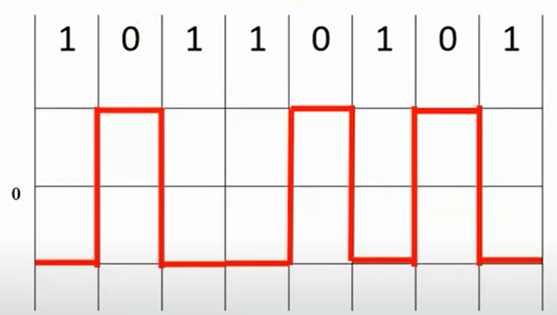
👨🏻‍🏫Polar NRZ-L
In this transmission the binary data may be presented by high voltage signals for the ones and negative voltages for the zeroes, or the opposite, for example the following figure shows how to represent the data 10110101, here we consider positive voltages for zeroes and negative voltages for ones.

Slide 4
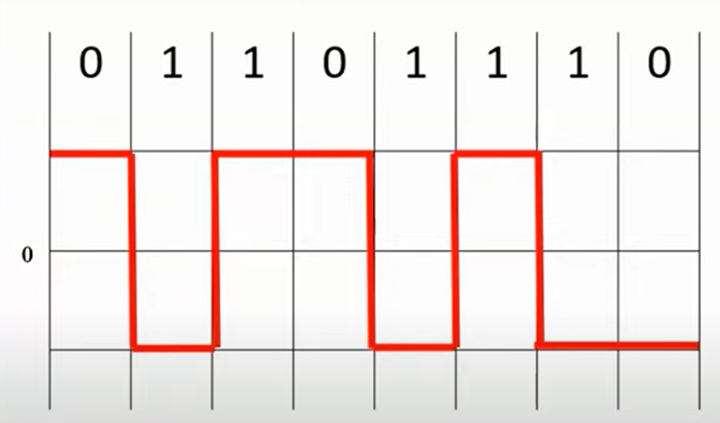
👨🏻‍🏫Polar NRZ-I
In this type of transmission, the ones are representing the change or the transmission, and the zeroes representing no transmission, or in other words, when we transmit zeroes we don’t change the signal, and when we transit ones we change the signal from high to low or from low to high, as in the following example, assuming positive logic.

Slide 5
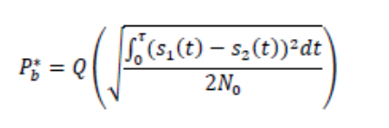
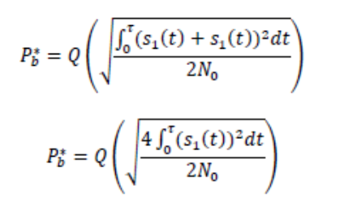
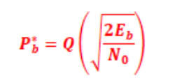
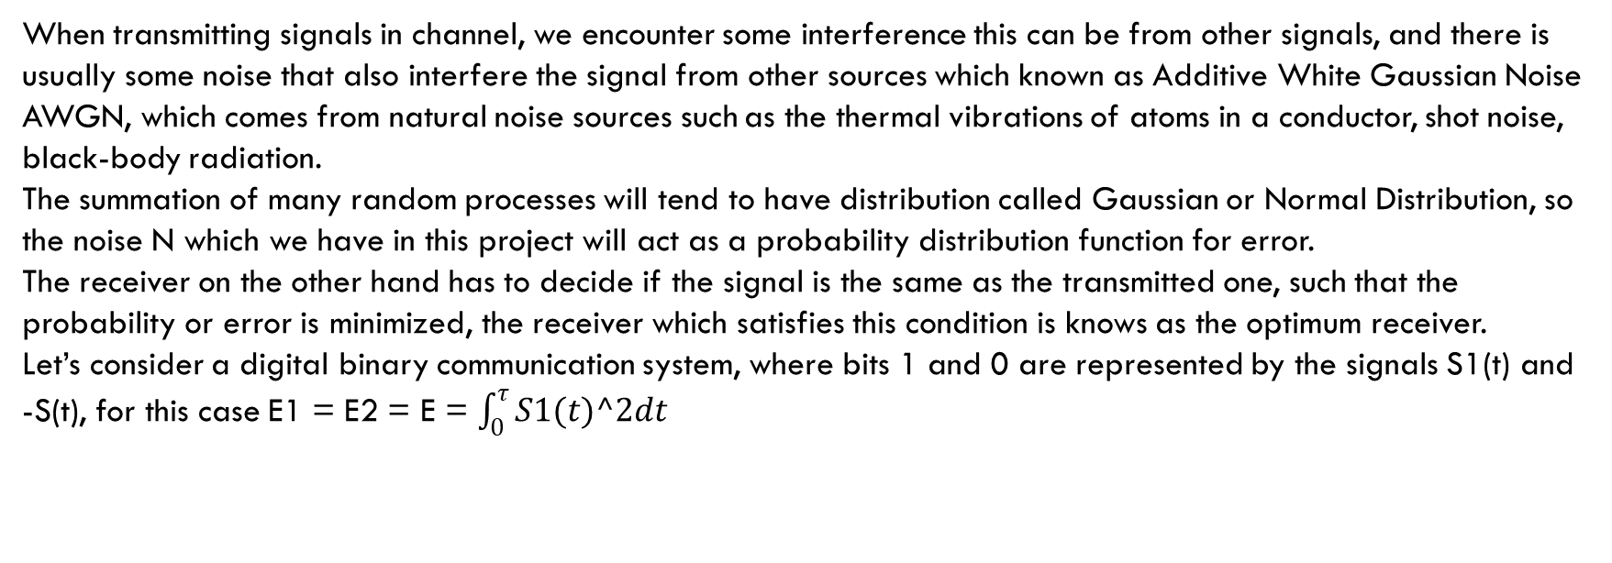
👨🏻‍🏫Additive White Gaussian Noise
When transmitting signals in channel, we encounter some interference this can be from other signals, and there is usually some noise that also interfere the signal from other sources which known as Additive White Gaussian Noise AWGN, which comes from natural noise sources such as the thermal vibrations of atoms in a conductor, shot noise, black-body radiation.
The summation of many random processes will tend to have distribution called Gaussian or Normal Distribution, so the noise N which we have in this project will act as a probability distribution function for error.
The receiver on the other hand has to decide if the signal is the same as the transmitted one, such that the probability or error is minimized, the receiver which satisfies this condition is knows as the optimum receiver.
Let’s consider a digital binary communication system, where bits 1 and 0 are represented by the signals S1(t) and -S(t), for this case E1 = E2 = E = $\int_{0}^{τ}{S1(t)^2dt}$

Slide 6
1. Build your complete system using Simulink, subject to the specifications given in table 1.

Slide 7
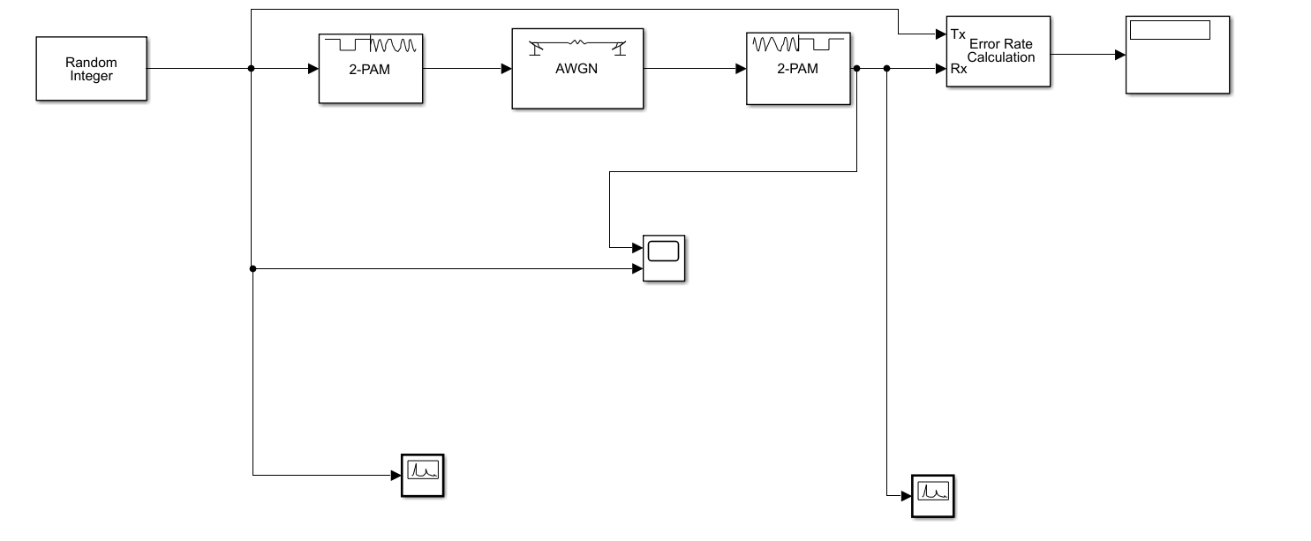
Block diagram of the system

Slide 8
2. Set M = 2, the simulation time to 1 sec and Es/No = - 5 dB. Run the program and compare the input data sequence to the output data sequence.

Slide 9
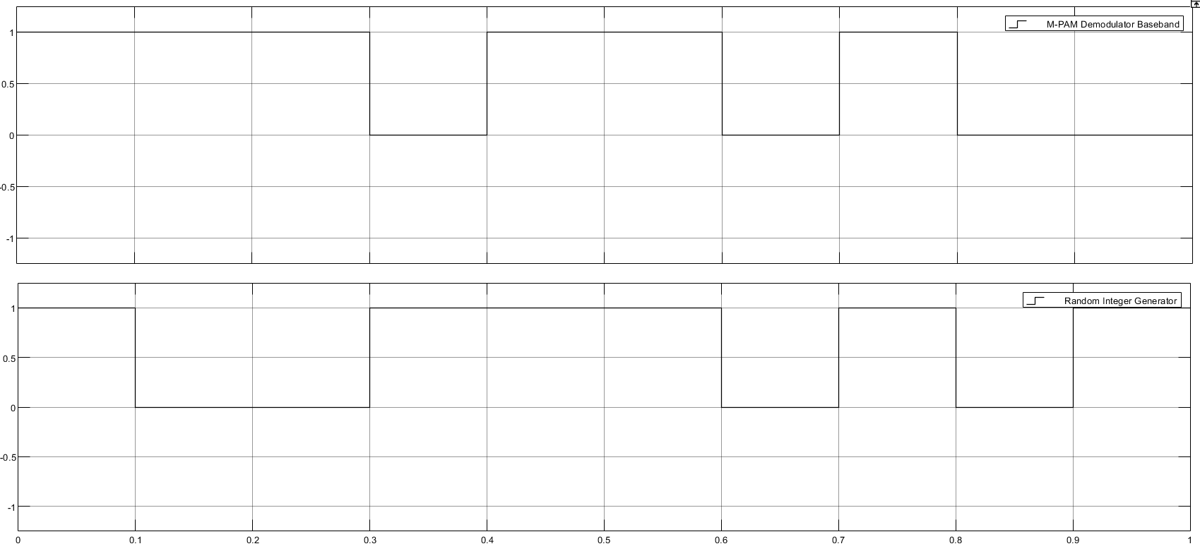
Input vs output

Slide 10
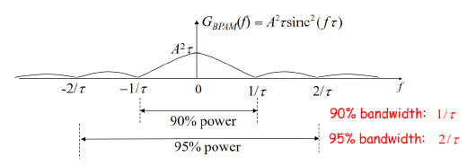
3. What is the 90% and 95% power bandwidth of the baseband signal in Hz?
90% =>1/tau = Rb = 10hz and the 95% bandwidth is double the 90% = 20hz

Slide 11
4. Set the simulation time to 1000 sec and Es/No = 0 DB. Run the program and obtain the probability of error. Compare this value with the theoretical result.

Slide 12
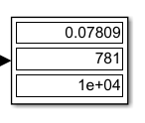
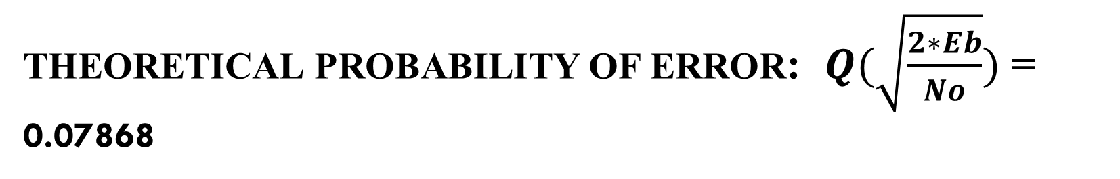
Experimental probability of error:
Theoretical probability of error: $Q(\sqrt{\frac{2∗Eb}{No}})$ = 0.07868

Slide 13
5. Compare the input and output power spectral densities and explain the reason for the similarity or/ differences when Es/No = 0 dB

Slide 14
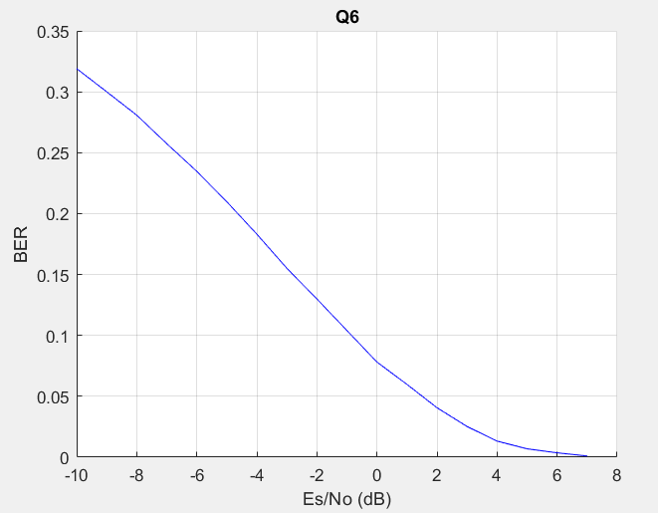
6. Plot Es/No corresponding to BER from -10dB to 7dB

